Slide 1
Defending the Budget
Tanner Purintun EAD 510

Slide 2
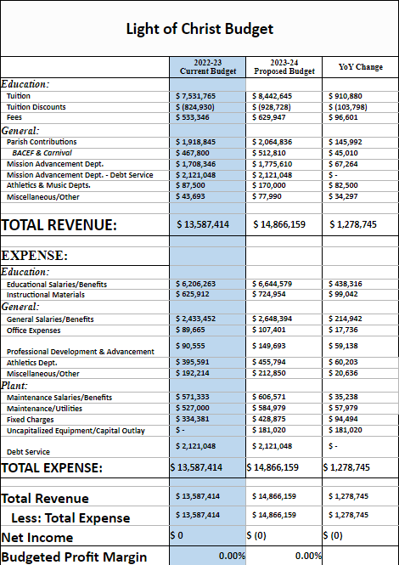
Budget Process
Feedback received from stakeholders (Teachers, Students, Parents, Administration)
Surveys
Meetings
Building Administrative Meetings
Align needs/wants to mission and vision
District Administrative Meetings
Project revenue and expenditures
Prioritize wants and needs
Board Approval
Notes:
The budget for Light of Christ Catholic Schools is created using a 21 step approach as seen on the next slide. This is to ensure that the budget is created in an ethical and transparent way and also aligns with the mission, vision, and core beliefs of Light of Christ. This process starts with the budgetary sub-committee projecting future revenue and expenses. The Vice President of Academic Affairs then solicits feedback from several key stakeholders. Several meetings then take place between the building principals and directors, along with district office employees. Ultimately the board must give final approval.

Slide 3
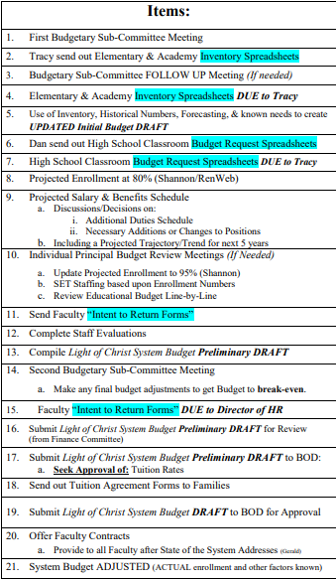
Budget Process Cont.
21 step process

Slide 4
Justification of Expenditures
Instructional Materials
$724,954
New Promethean Boards
New Curriculum
Aligns with goals of Continuous Improvement Plan
Professional Development
$149,693
Notes:
The three main goals of the continuous improvement plan for SMCHS is as follows: Increased opportunities for students to be actively involved in the learning process, provide frequent and consistent opportunities for data analysis, promote Catholic beliefs to support the vision and mission of Light of Christ Catholic Schools. In order to achieve these goals, we must provide adequate technology and curriculum to engage our students, we also much provide professional development to train and equip our staff.

Slide 5
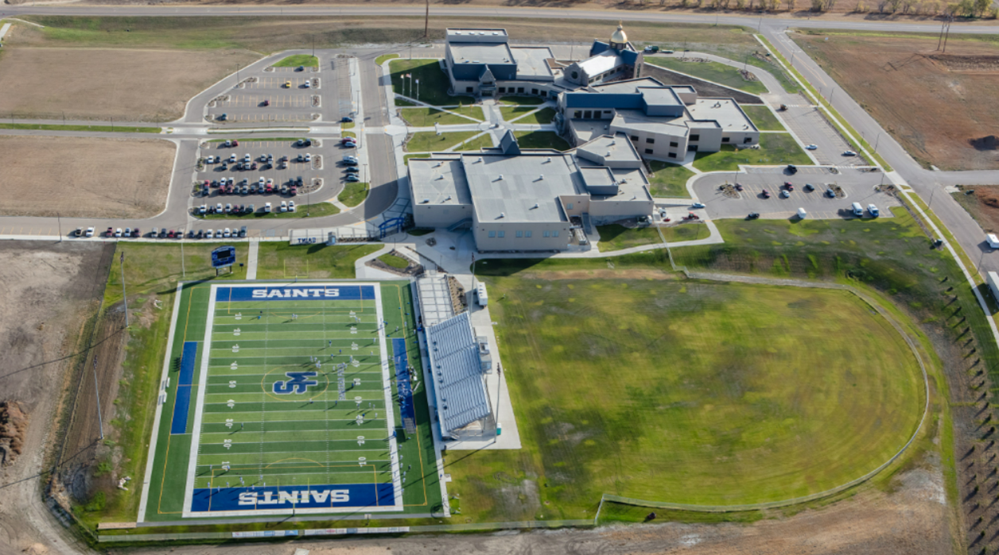
Justification of Expenditures Cont.
Maintenance/Utilities
$584,979
Lights, Heat, Air Conditioning, Grounds Keeping
Could cut $10,000
Water for lawn
Notes:
There are also non-negotiables for maintenance and utilities. We need to have a functioning campus. We must be able to turn the lights on, have adequate heating and air conditioning, and we also must plan for snow removal. If we do not, we risk not having an adequate learning environment for our students. One area that we could cut is the amount in which we water our lawn. There is risk involved in case we have a drought. However, having a brown lawn is better than cutting a teaching position.

Slide 6
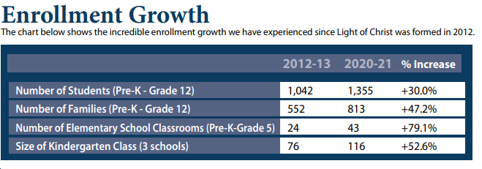
Alternate Solution
Cutting a teaching position does not align with the mission & vision of SMCHS
We would explore not hiring a position of someone who retired.
Cut maintenance costs
Monetize our facilities more
Too much growth to cut a teaching position
Notes:
Rather than cutting a teaching position, I would propose an alternative solution. Because of the growth Light of Christ Catholic Schools has seen in the last decade, it would not make sense for us to cut a teaching position. Worst case scenario, we would consider not rehiring for a retirement if we felt like that position was not necessary. However, there are very few positions like that within the school system, and none of them are set to retire for a couple more years. Instead, we would look to cut maintenance costs and monetize our facilities more.

Slide 7
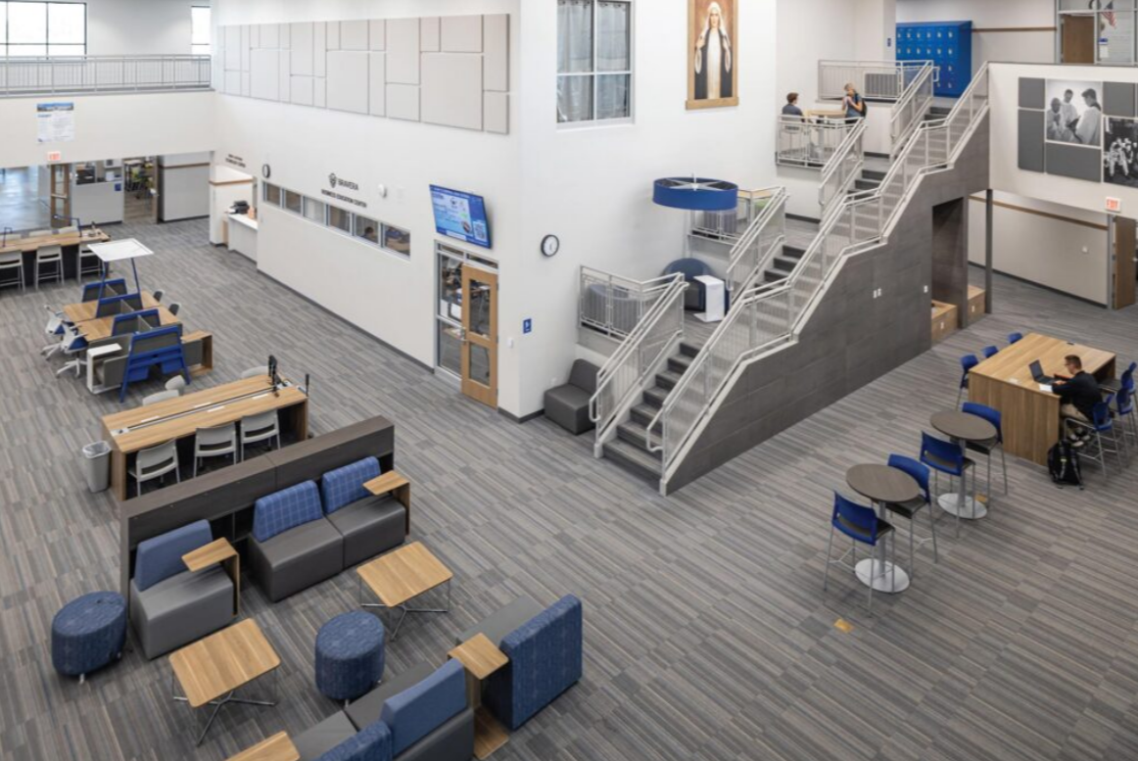
Alternate Solution Cont.
Budget Cut
Uncapitalized Equipment/Capital Outlay
$181,020
Cut back however much is necessary
Building projects can be postponed
Minimal upkeep to a brand new school
Notes:
The biggest area we could see budget cuts is to our own facility. St. Mary’s Central High School opened a brand new school in 2019. There are always capital improvements that could be made. However, there are also a lot of capital improvements that could be postponed and pushed further down the road. We have $181,020 budgeted for this area in 2023-24. If the school was in that desperate of a situation, I am confident that we could cut back in this area to make sure a teaching position would not need to be cut.

Slide 8
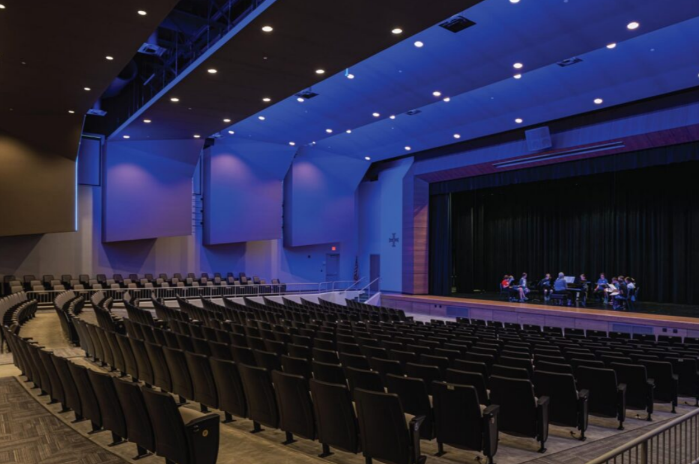
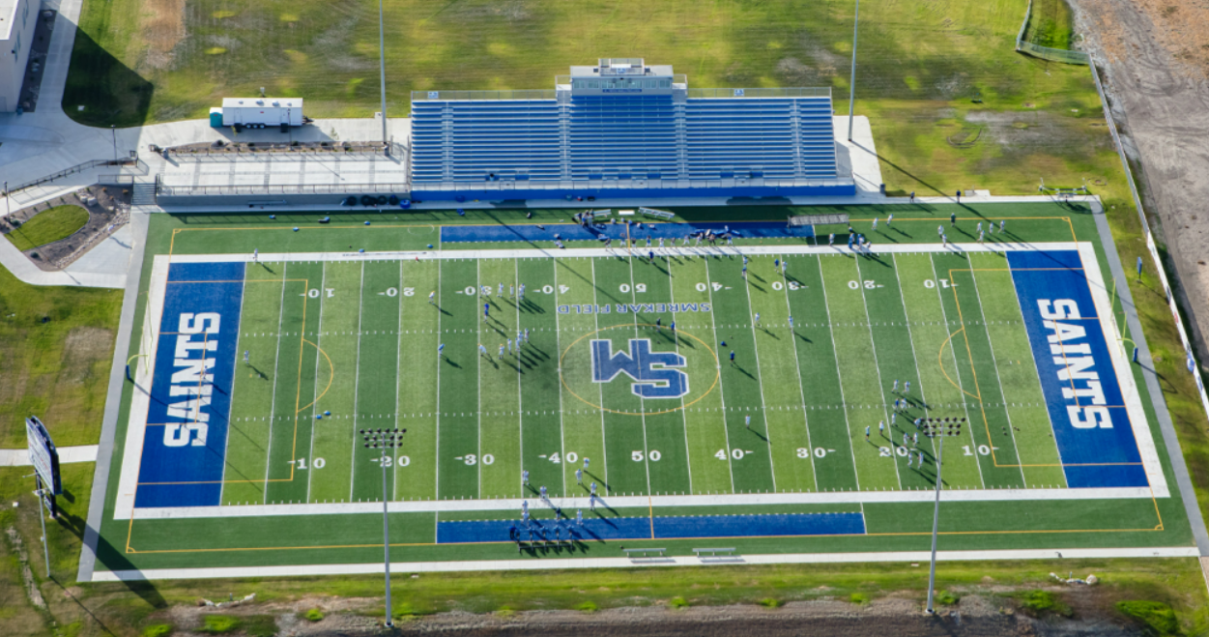
Alternate Solution Cont.
Facility Rentals
Auditorium/Athletic Facilities
Increased Revenue
$10,000-$25,000
Notes:
We also could monetize our facilities more. I am the Activities Director and I was told to be very strict on who we rent our facilities to. Because of this, we very rarely rent out our state of the are auditorium, gymnasiums, or football complex. I have declined roughly 25 requests this year that would’ve brought in money. If we desperately needed money to offset the cost of a teacher, I am confident we could bring in another $10,000-$25,000 in facility rental.

Slide 9
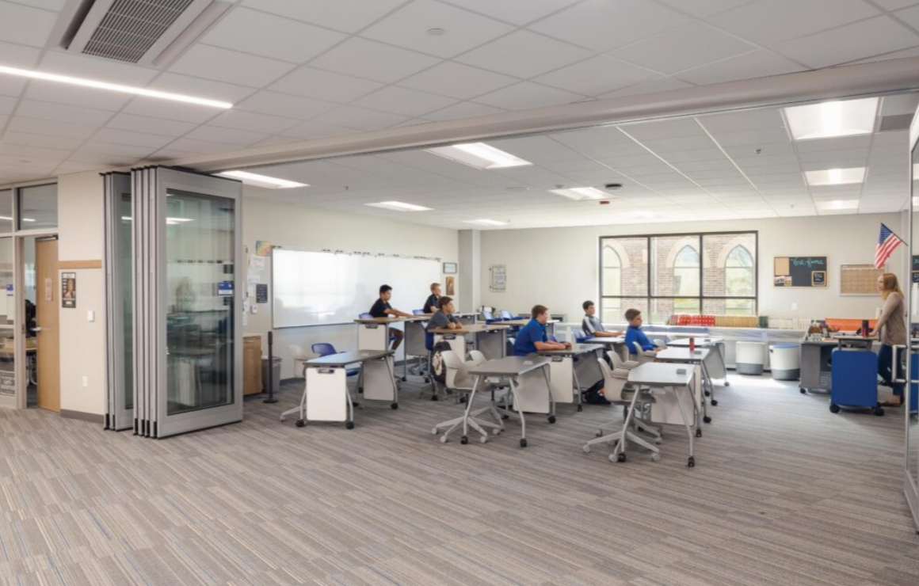
Continuous Improvement
Goals
Increased opportunities for students to be actively involved in the learning process.
Provide frequent and consistent opportunities for data analysis.
Promote Catholic beliefs to support the vision and mission of Light of Christ Catholic Schools.
Need teachers to carry out and achieve these goals
Emphasis on teacher development
Cutting position would be detrimental to CIP
Notes:
My alternative solution promotes continual and sustainable school improvement and upholds the school vision/mission and the values of democracy, equity, and diversity. In order to achieve the goals from our continuous improvement plan, we cannot cut a teacher. That would be detrimental to our CIP and the exact opposite direction we want to go in as a school. Not only would it affect the teaching position we cut, but it would also create a shockwave across the entire district and make all other teachers nervous. (Goldhaber et al., 2016) This would make it harder for Light of Christ to build a great culture and meet our goals from the CIP.

Slide 10
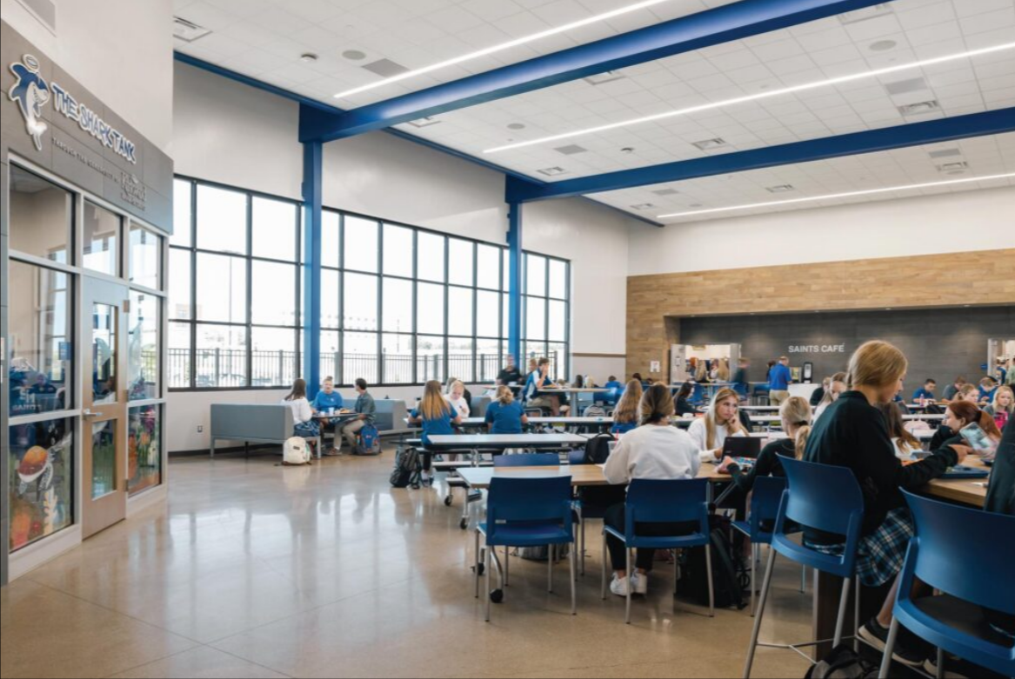
Mission, Vision, Core Beliefs
Mission
Encountering Christ in our Catholic Faith through living, learning, and serving.
Vision
Inspire and prepare the heart, soul, and mind of future generations to radiate the Light of Christ.
Core Beliefs
Encountering Christ
Cultivating Virtues
Inspiring Christ-like Relationships
Academic Excellence
Safe Environment
Notes:
Teachers are the front lines to carry out the mission, vision, and core beliefs of the school. Cutting someone from the front line would be setting our school up for failure. “Studies find that teacher layoffs harmed student achievement and were equitably distributed across schools, teachers, and students.” (Kraft & Bleiberg, 2022)

Slide 11
Human, Fiscal, Technological Resources
Return on Investment
Student Impact
Money
Notes:
We want to make sure this plan efficiently uses human, fiscal, and technological resources to manage school operations. When budgeting we look at “return on investment”. We take into consideration two types of return. One is student impact, and the other is financial gain. There are positions within Light of Christ that bring in 3x their salaries. Those are positions that we would never consider cutting. There are also positions that make extreme impact on students (teachers). This is why I would do everything in my power to avoid a situation involving cutting a teacher.

Slide 12
Mobilization of Community Resources
Cut Maintenance
Seek Specific Donations
Project costs onto students
Raise fees
Identify the risk we are willing to accept
Notes:
This plan proposes the mobilization of diverse community resources to support areas cut in the new budget by soliciting specific donations. If we cut maintenance costs and did not take on specific capital improvement projects, we would go to our local contractors, local hardware stores, and other business and solicit specific “in-kind” donations or services that could potentially get us by. We would also ask our families to take on more cost and I am confident they would step up to the plate.

Slide 13
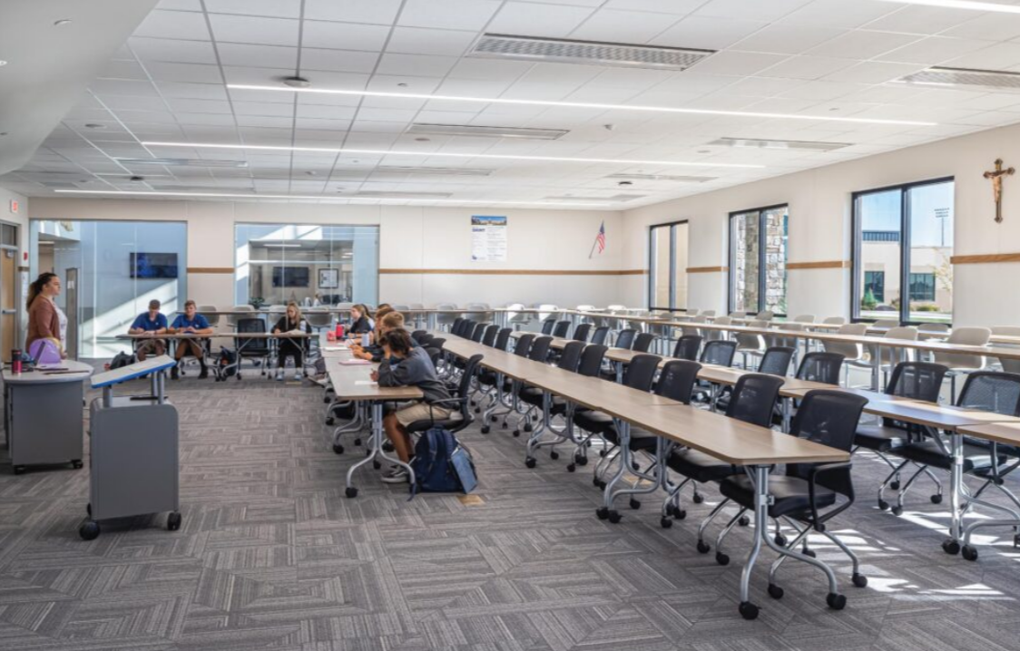
Student Needs
St. Mary’s Central High Schools is committed to:
Never turning away a student because of lack of space or lack of finances
Offering smaller class sizes
Good teacher to student ratio
Notes:
My plan advocates for student needs because St. Mary’s Central High School is committed to never turning away a student because of lack of space or lack of finances. SMCHS is also committed to offering smaller class sizes with a great teacher to student ratio. Cutting a teacher is not the answer to achieve these goals.

Slide 14
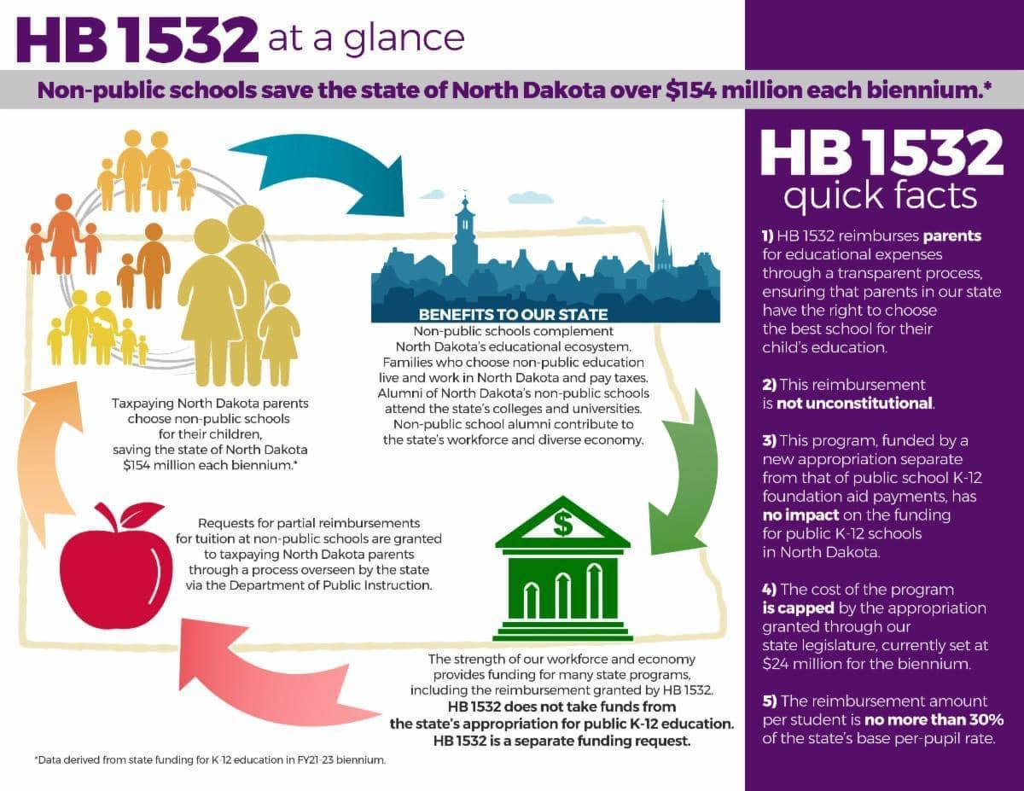
Current Political and Emerging Trends
HB 1532
Would give reimbursements to parents
Notes:
This plan is also responding to a current bill that has already passed the ND House of Representatives and will be voted on by the ND Senate next week. HB 1532 would provide reimbursements to parents that choose to educate their child in a private school. If this bill passes, I believe the growth within the Light of Christ school system would dramatically increase. This means we need teachers.

Slide 15
Monitor/Evaluation of Plan
Dan Neff
Vice President of Finance/Operations
Monthly Budget Reports
Sent to Building Principals and Directors
Notes:
In essence the Vice President of Finance and Operations monitors and evaluates this plan. He sends out monthly budget reports to building principals and directors and ensures that everyone is being held accountable for their departments.

Slide 16
References
Goldhaber, D., Strunk, K. O., Brown, N., & Knight, D. S. (2016). Lessons learned from the Great Recession. Educational Evaluation and Policy Analysis, 38(3), 517–548. https://doi.org/10.3102/016237371664797
Kraft, M. A., & Bleiberg, J. F. (2022). The inequitable effects of teacher layoffs: What we know and can do. Education Finance and Policy, 17(2), 367–377. https://doi.org/10.1162/edfp_a_00369

